Slide 1
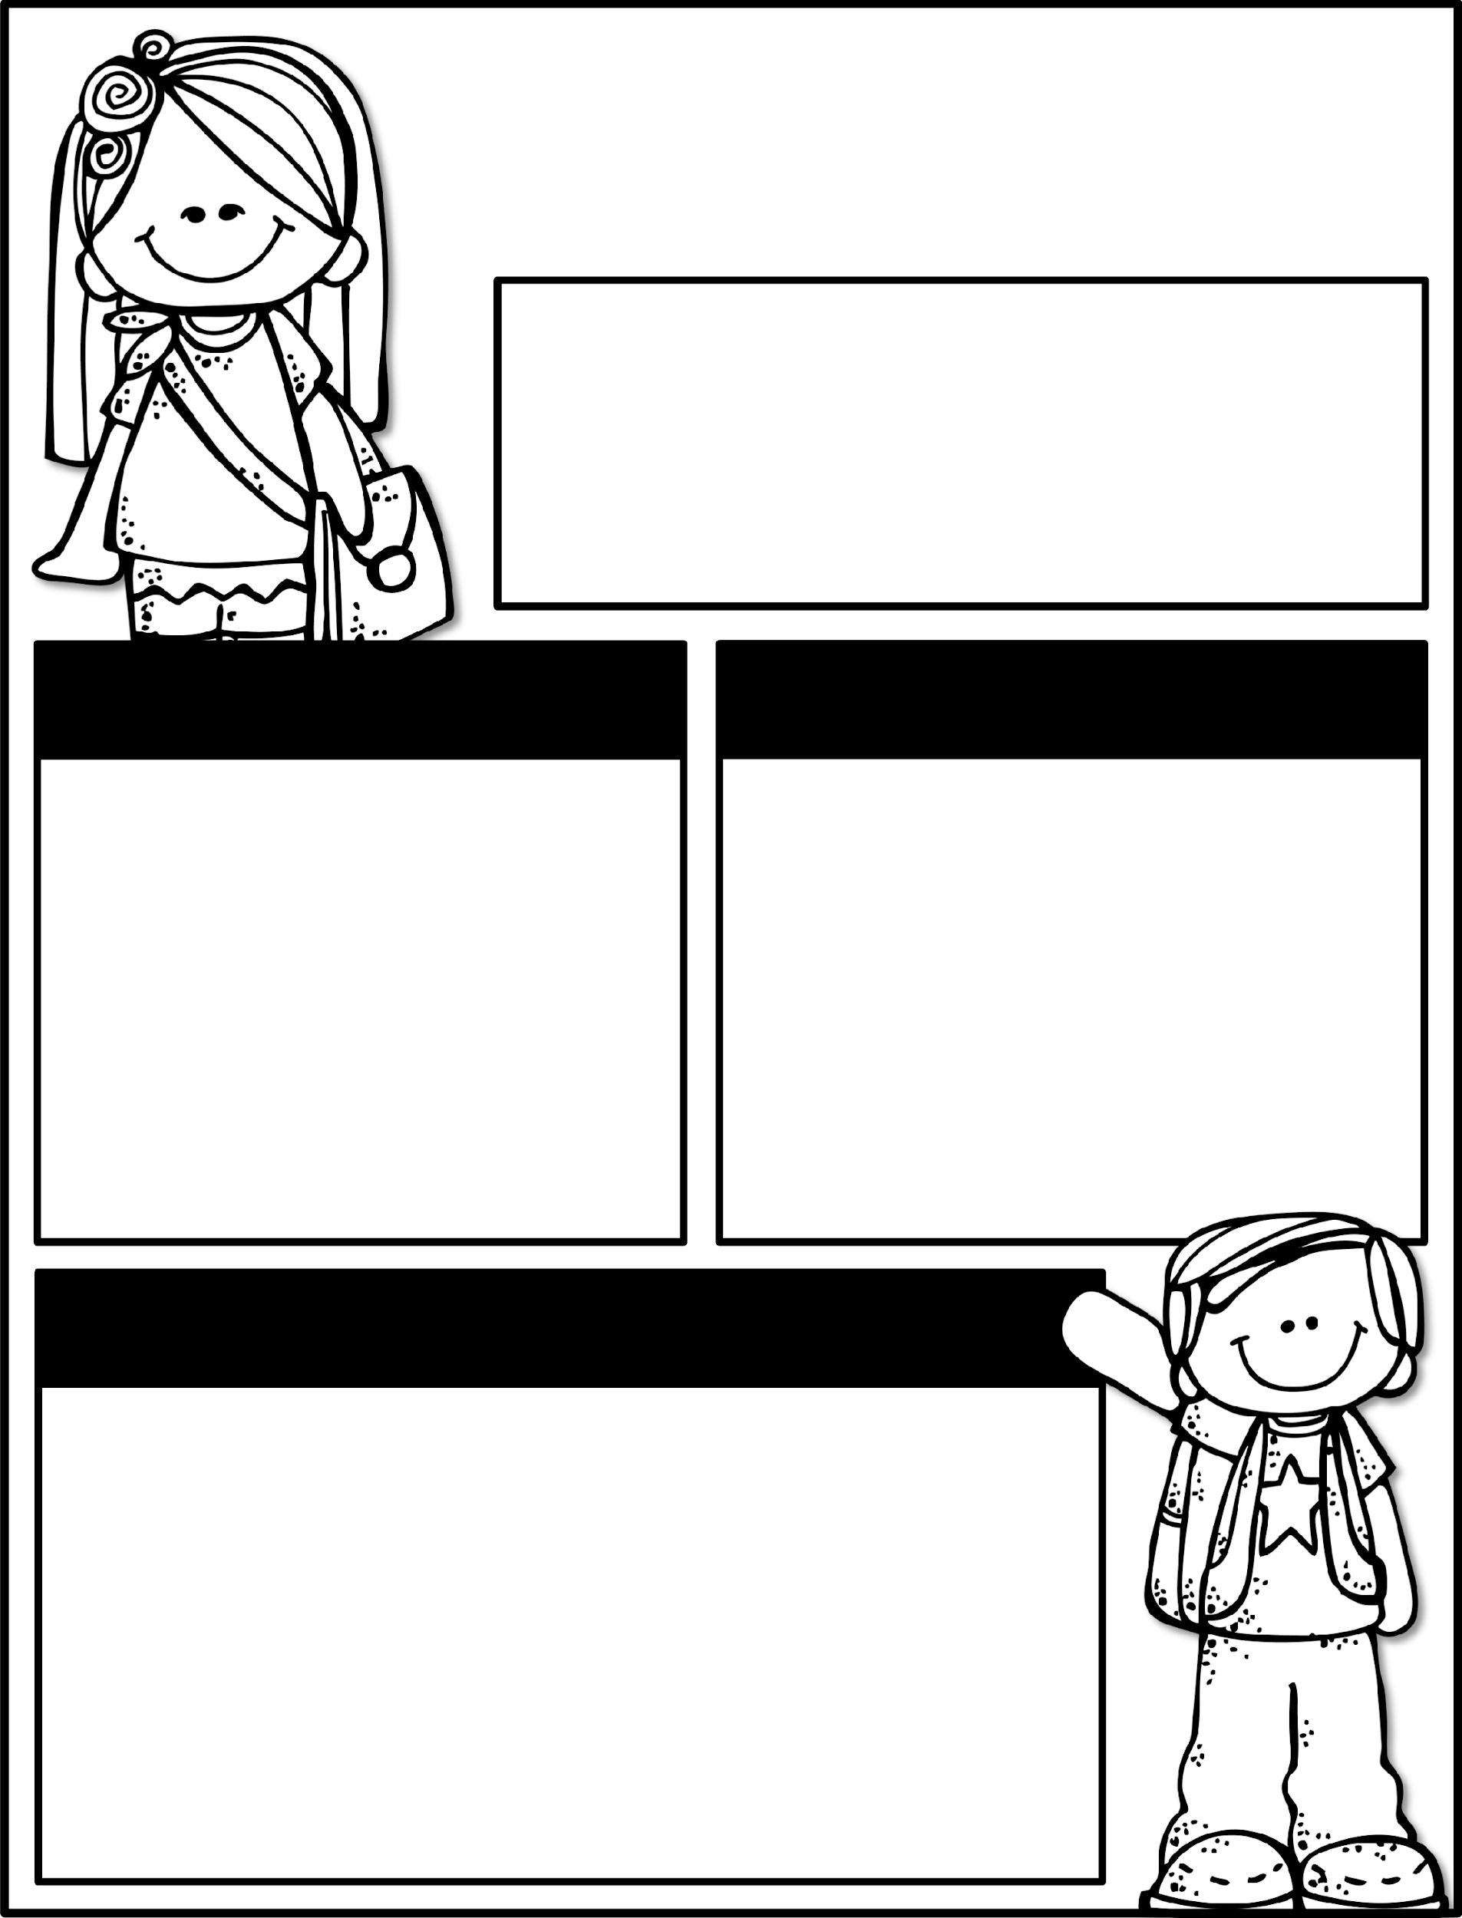

Kindergarten News
October 7-11, 2024
Class News
Learning Focus
Our field trip is coming up soon! If you’d like to be a chaperone, background check forms should have already been turned in and must be approved by the county before our field trip. If it was turned in recently, we cannot guarantee that they will come back before we go. Any adult listed on the yellow card may come as a chaperone.
Thursday, October 17th will be the 50th Day of School and we will celebrate by having a 50s Day Themed celebration!
Upcoming Events
Learning Focus
10/17- 50th Day of School
10/18- Field Trip/T-Shirt Forms & Money Due
10/18 – Kona Ice
10/25- Pink Out Day
10/28-11/1 Red Ribbon Week
10/30- Fall Picture Retakes
10/31 - Kinder Candy Count (please send in one bag of candy)
Birthdays
Liam 10/12
Ember 10/24
Reading: Asking and answering questions about key details, characters, and setting
Writing: Informational text
Math: Counting “one more” and “one less”
Phonics: Letters / Letter sounds
Science: Forces and Motion
Sight words to practice
a, the, as, to, do, I, is, am, at, an, man, in, it, was, you, from , your
Contact Me:
Email: olivia.otis@henry.k12.ga.us
School Phone Number: 770-898-7362
Reminders
Please check your child’s binder each night. Check Dojo each night.
Ask questions if you have them!
Please send a water bottle and daily snack for your child.
Please keep a change of clothing in your child’s bookbag .
We have completed the GKIDS assessments. This measures what your child knows entering kindergarten. Your child’s report will be his/her first report 9-week report card.

